Slide 1
State Design Pattern
The State pattern provides state-specific logic to a limited set of objects in which each object represents a particular state.
A behavior is defined on a state object that is responsible for running some handler when the overall state transitions to its own state. The interface that these state objects operate on is called the Context.
State pattern is used to provide a systematic and lose-coupled way to achieve this through Context and State implementations.
@ShankaragoudaG

Slide 2
State Design Pattern
The most important problem it solves is when your state becomes large and there are many cases.
It becomes hard to debug issues when our application's state can change in many ways especially when our application becomes enormous.
redux is a library that is succeessful in providing an easy-to-use, predictable interface to solve complex state issues.

Slide 3
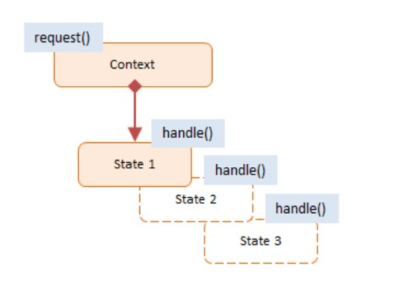
Diagram
Context:
exposes an interface that supports clients of the service
maintains a reference to a state object that defines the current state
allows State objects to change its current state to a different state
State:
encapsulates the state values and associated behavior of the state

Slide 4
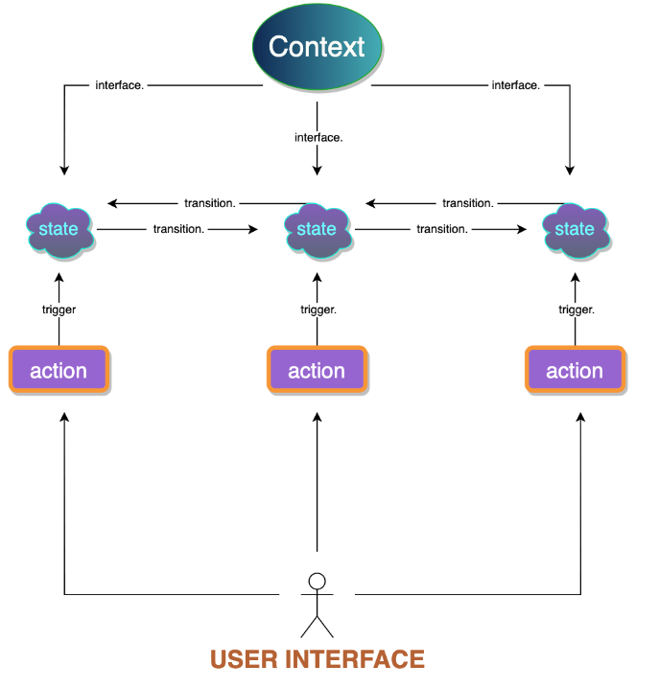
Visual Representation

Slide 5
Example
Traffic light (i.e. TrafficLight object) with 3 different states: Red, Yellow and Green, each with its own set of rules.
The rules go like this: Say the traffic light is Red. After a delay the Red state changes to the Green state.
Then, after another delay, the Green state changes to the Yellow state.
After a very brief delay the Yellow state is changed to Red. And on and on.

Slide 6
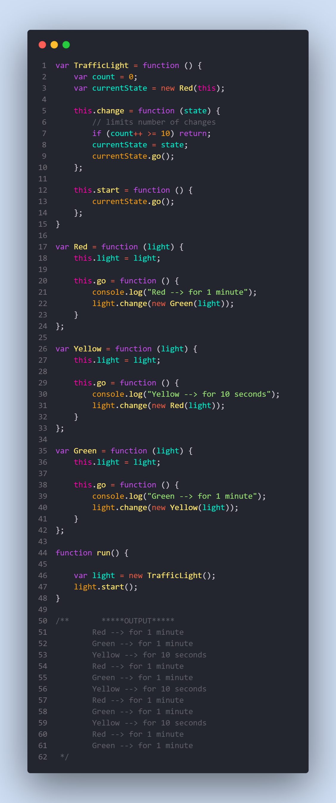

Slide 7
Useful Resources
https://jsmanifest.com/state-design-pattern-in-javascript/
https://www.dofactory.com/javascript/design-patterns/state
https://refactoring.guru/design-patterns/state
https://www.geeksforgeeks.org/state-design-pattern/

